Slide 1

Developer Weekend 2019
MAKING RIGHT CHOICES
Sayantika Banik
Backend Engineer @ContinualEngine

Slide 2

Welcome to confusion club!
ACADEMICS +PROFILE +JOB &&FUN

Slide 3
94% OF GRADUATES AREN'T FIT FOR HIRING
A MCKINSEY REPORT

Slide 4


WHAT IS THE CAUSE?
Lack of communication skills
Lack of awareness
Legacy curriculum
Zero Industrial exposure

Slide 5

88%
CAN'T GO A DAY
WITHOUT BEING ONLINE
12%
CAN GO A DAY
WITHOUT BEING ONLINE
approx figures

Slide 6

YOU AND I ARE
VICTIMS
BELIEVE IT OR NOT

Slide 7


TAKE A BREAK AND THINK

Slide 8



LKI RULE
WHAT DO U LIKE?
DO YOU HAVE SUFFICIENT KNOWLEDGE ?
TRY TO IMPLEMENT
Don't limit yourself to tech/non-tech etc.
Give it an open thought.
Take up small tasks/assignments in order to make clear choices.
Align your interests with the real world.

Slide 9
HOW DID I DEAL WITH MY CARRIER CHOICES?

Slide 10


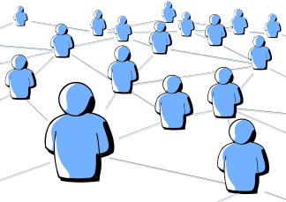

HACKATHONS
OPEN SOURCE
COMMUNITIES
INTERNSHIPS

Slide 11
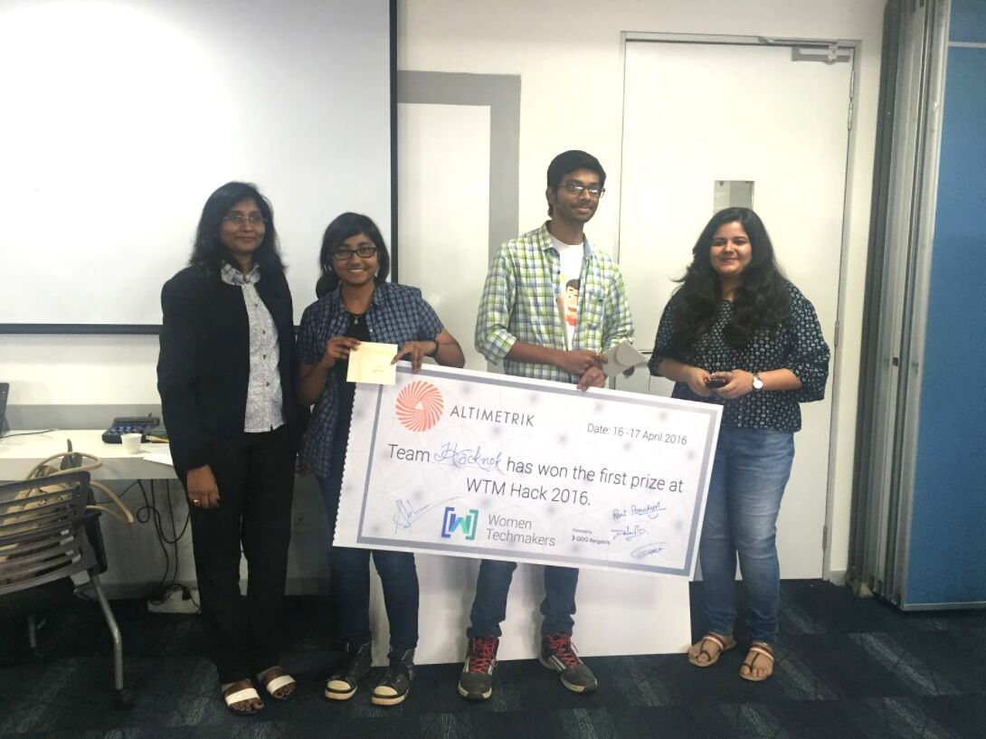
MY FIRST HACKATHON
(WTM HACK 2016)

Slide 12

LESSONS LEARNED
ALL IT TAKES IS COURAGE
EVERY IDEA IS WORTH GIVING A TRY
BE PATIENT IN THIS JOURNEY

Slide 13
WHAT IS OPEN SOURCE?
It's not free, but free to be utilized with necessary license in place.
(Deepest respect)
OPEN
SOURCE
WHAT OPEN SOURCE IS NOT?
Its not just code !!
HOW TO GET STARTED?
Let's discuss

Slide 14
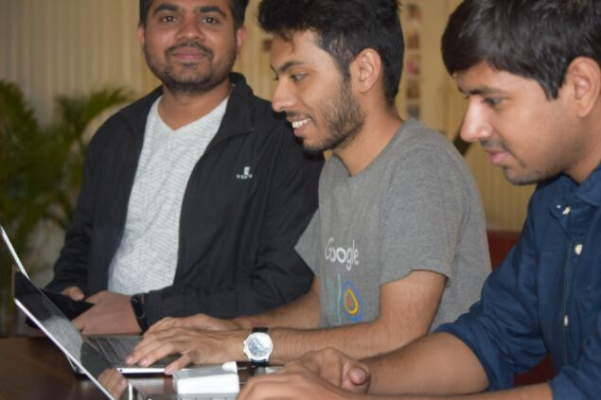
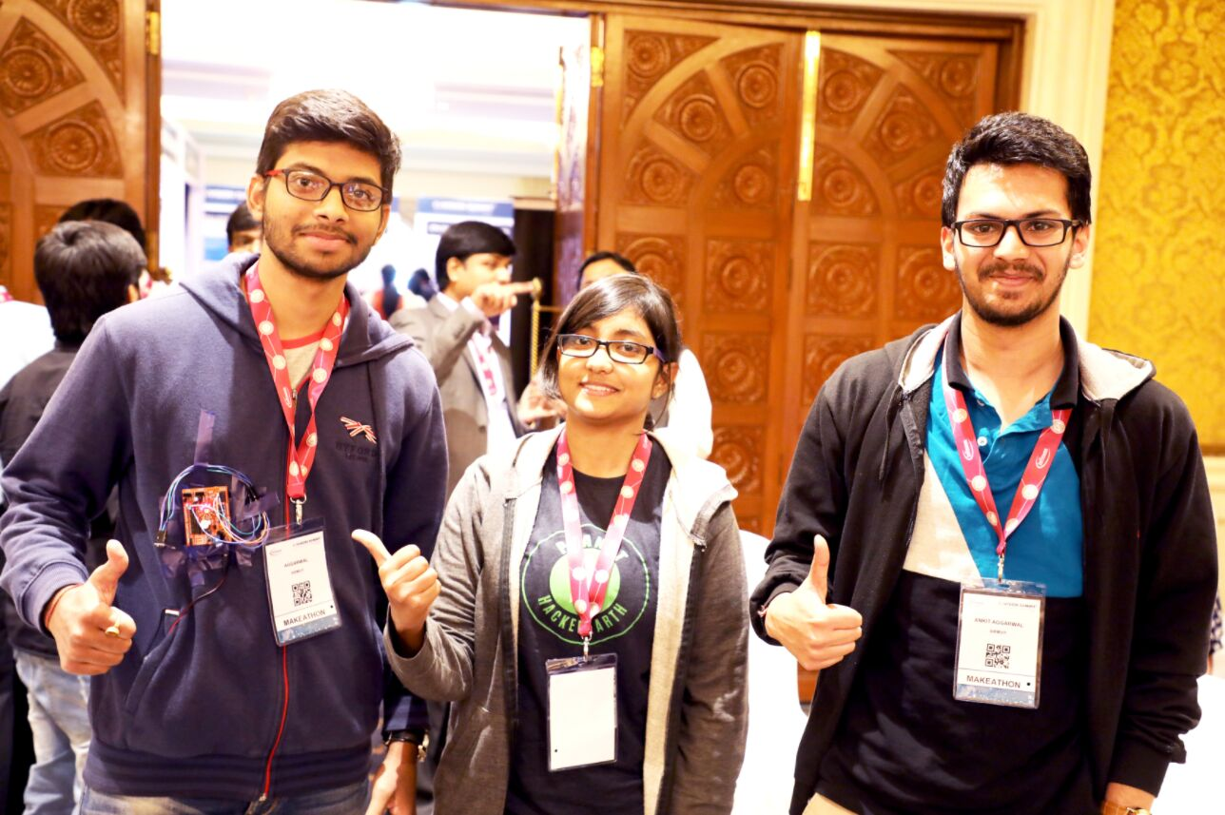
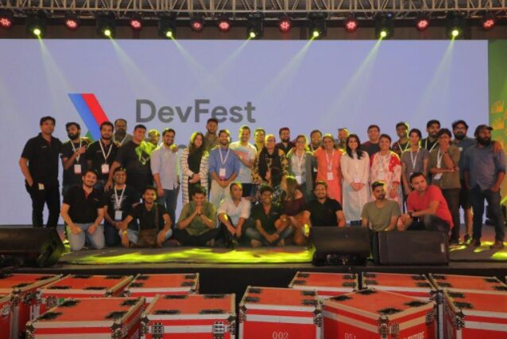
COMMUNITIES

Slide 15



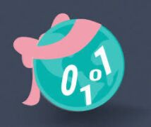

COMMUNITES ARE
GDG BANGALORE
WTM BANGALORE
GIRLSCRIPT FOUNDATION
LEARN IT, GIRL

Slide 16

LEARN, IMPLEMENT &
EXECUTE

Slide 17


RECAP
SUCCESS + FAILURE == YOU ARE READY

Slide 18
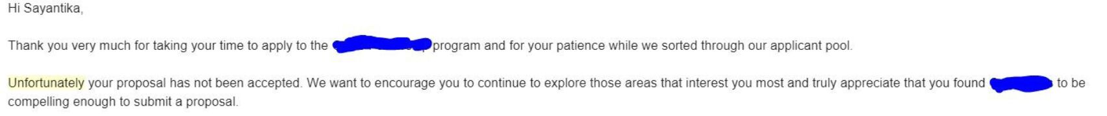
99%
I FAILED
I CHEER IT TODAY !

Slide 19

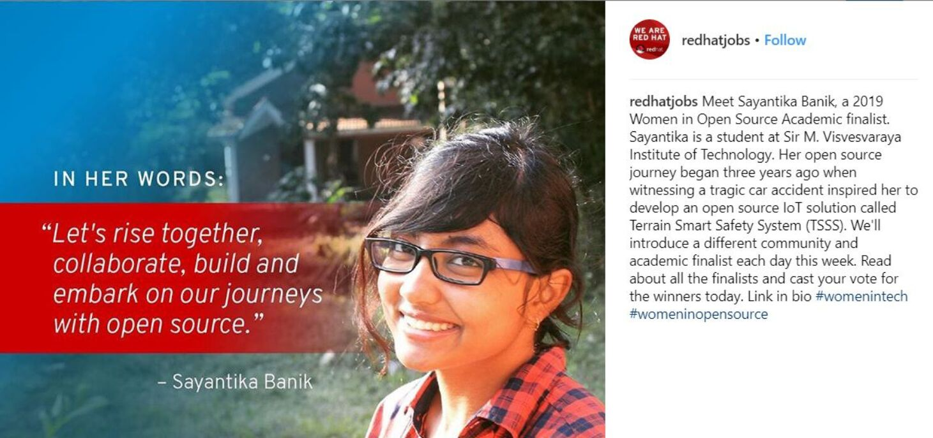

Slide 20

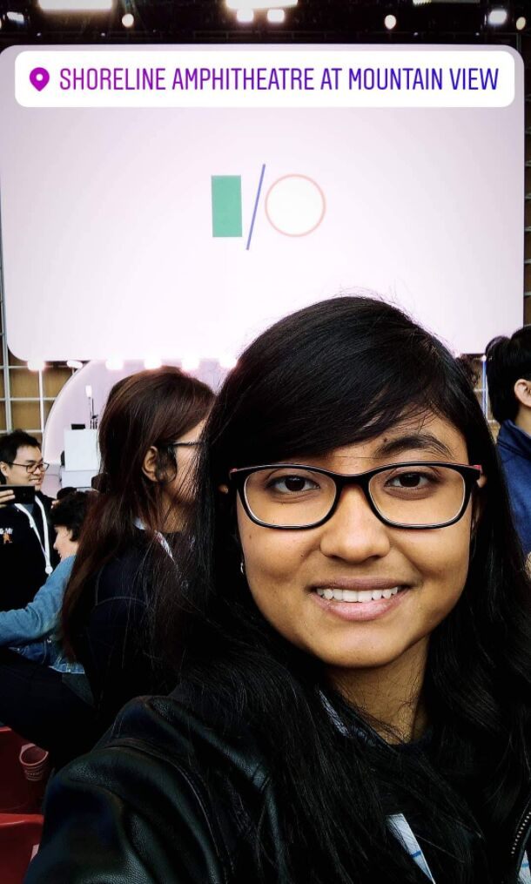
I/O 2019

Slide 21

DON'T GIVE UP
“I cannot inspire, but sure wish to dig in tiny seeds of aspiration.”
-SAYANTIKA (JUST A NORMAL HUMAN)

Slide 22

@sayabanik

